Slide 1
Capstone Project-1
Hotel Booking Analysis
●
●
by – Vijay N

Slide 2
Table Of Contents
Problem Statement
Overview Of The Given Data And Problem
Steps Followed In Analysis
Understanding The Dataset Provided
Data Overview
Data Cleaning
EDA On Dataset
Univariate Analysis
Bivariate Analysis
Multivariate Analysis
Conclusions
Suggestions

Slide 3
Problem Statement
Have you ever wondered when the best time of year to book a hotel room is? Or the optimal length of stay in order to get the best daily rate? What if you wanted to predict whether or not a hotel was likely to receive a disproportionately high number of special requests?
This hotel booking dataset can help you explore those questions!
This data set contains booking information for a city hotel and a resort hotel, and includes information such as when the booking was made, length of stay, the number of adults, children, and/or babies, and the number of available parking spaces, among other things.
All personally identifying information has been removed from the data. Explore and analyze the data to discover important factors that govern the bookings.

Slide 4
Overview of the given data and problem:
We are provided with hotel bookings dataset of the following years – 2015 to 2017
.
This dataset is unstructured, contains a lot of null values and needs cleansing.
Other than that , there are going to be certain data columns that we won't be needing so ﬁltering is required.
After proper Filtering and cleansing, We are going to analyse this dataset and try to gain insight and analyse factors that govern these bookings.
We will be using some libraries such as Numpy, Pandas and Matplotlib for different task such as managing arrays, working on dataframes and visualizing data.
We will be using data visualization to depict everything graphically.

Slide 5

Steps Followed In Analysis
Data Collection
Exploratory
Data Analysis
Data
Visualization
Data Cleaning
Data collection : We collected the hotel booking data on which EDA is to be done. We then understood the data, its columns/features and its content.
Data cleaning : We cleaned the data by dropping or replacing null values, deleting unwanted columns, checking data type and conversion to a data type of required column and we performed many other operations to get the required dataset.

Slide 6
Steps Followed In Analysis
EDA will be divided into following analysis:
Univariate Analysis: Univariate analysis is the simplest of the three analysis where the data you are
analyzing is only having one variable.
Bivariate analysis: In Bivariate analysis we will compare two variables to study their relationships.
Multivariate analysis: Multivariate analysis is similar to Bivariate analysis here we will compare more than two variables.

Slide 7
Understanding The Dataset Provided
The data has 119390 rows and 32 columns or features. Now let’s understand what these columns have.
All columns heading and data description:
hotel : Hotel type.
is_canceled : booking is canceled or not (0 & 1).
lead_time : advance booking time
arrival_date_year : guests arrival year.
arrival_date_month : guests arrival month.
arrival_date_week_number : guests arrival week.
arrival_date_day_of_month : guests arrival day.
stays_in_weekend_nights : weekend nights bookings
stays_in_week_nights : weeknights bookings
adults : Number of adults.
children : number of children.
babies : Number of babies.
meal : Type of meals
country : Country of origin

Slide 8
Understanding The Dataset Provided
Continued-
market_segment : where the bookings came from.
distribution_channel : Booking distribution channel.
is_repeated_guest : repeated guest (1) yes or not (0).
previous_cancellations : previous bookings that were cancelled
previous_bookings_not_canceled : previous bookings that were not cancelled
reserved_room_type : Code of room type reserved.
assigned_room_type : Code for the type of room assigned to the booking
booking_changes : Number of changes/amendments made to the booking
deposit_type : Indication on if the customer made a deposit to guarantee the booking.
agent : ID of the travel agency that made the booking.
company : ID of the company/entity that made the booking
days_in_waiting_list : Number of days the booking was in the waiting list
customer_type : Type of booking, assuming one of four categories.
adr : Average Daily Rate
required_car_parking_spaces : Number of car parking spaces required to customer.
total_of_special_requests : Number of special requests
reservation_status : Reservation last status
reservation_status_date : Date at which the last status was set.

Slide 9
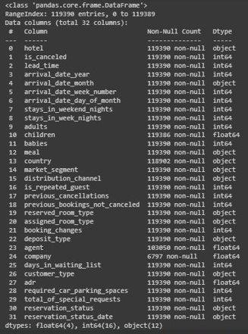
Data Overview
We took a overview of the data together by using
many methods such as .head() , .tail() , .describe(), shape , .info() and etc.

Slide 10
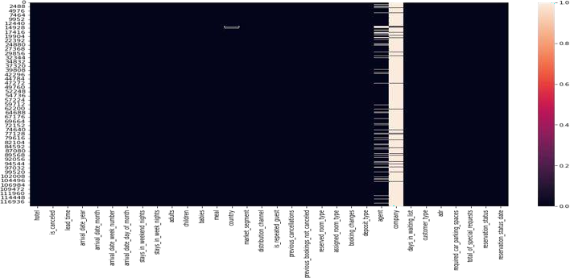
Data Cleaning
Found null values in following columns and took actions accordingly
Children - replaced all missing 4 values with 0(int64).
Country - replaced all the missing values with “not mentioned”.
Company - Deleted the column as it was not useful.
Agent- Deleted the column as it was not useful.

Slide 11
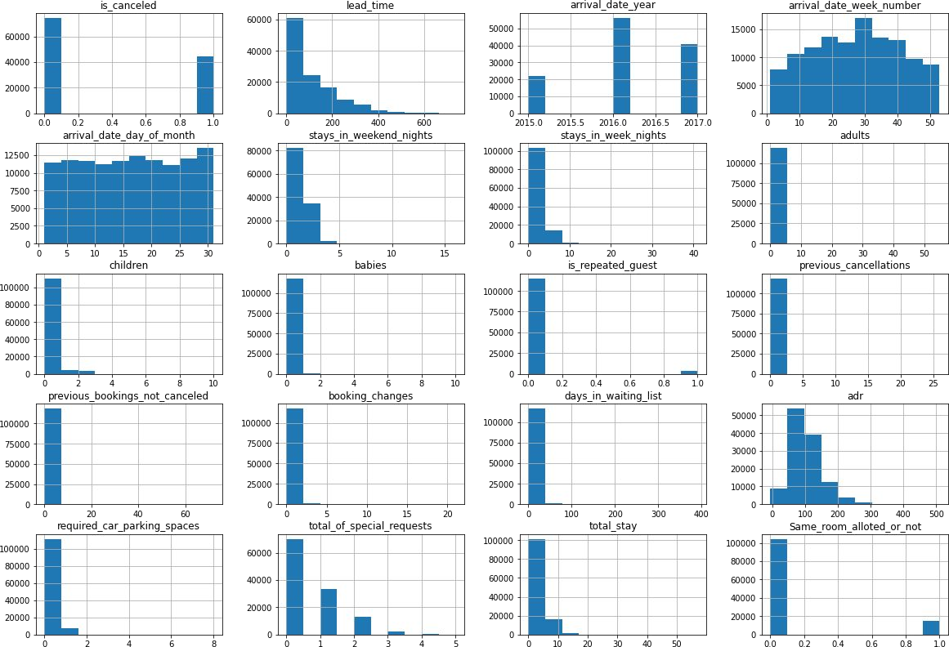
EDA on Dataset
Brief of various column trends:
Before we start getting insights from data here are histograms to have a brief picture of various column trends and data.
All columns with data type int64 are represented in histograms

Slide 12
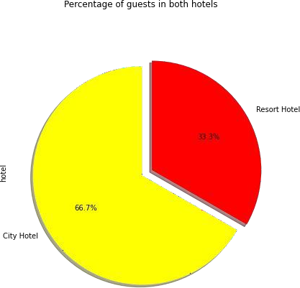
EDA- Univariate Analysis
1. Most Preferred Hotel By The Guests
Ratio of Booking
City Hotel is most preferred hotel by the
guests having 66.7% weightage.
Resort Hotel is less preferred having 33.3%
weightage.

Slide 13
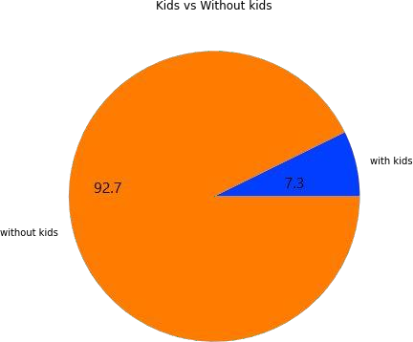
2. Adults Travelling with Kids Or without Kids
Maximum Adults are traveling without any kids which are almost 92.7%.
Only 7.3% Adults are traveling with
kids.

Slide 14
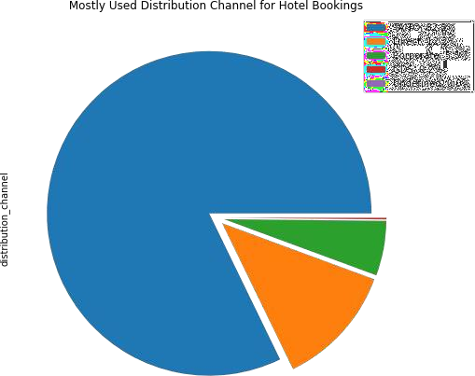
3. Most Preferred Distribution Channel For Hotel Booking
82.2% booking were done from channel TA/TO(“TA” means “Travel Agents” and “TO” means “Tour Operators”).
2nd most preferred channel for booking is Direct booking.

Slide 15
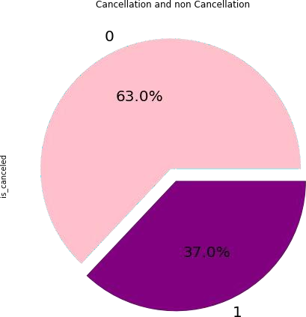
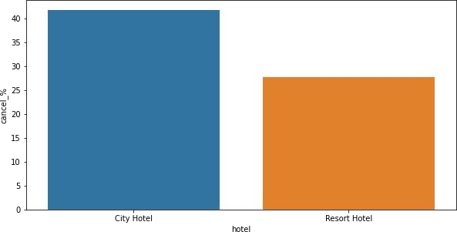
4. Hotel Booking Cancellation rate
City Hotel Booking cancellation rate is 41.73%.
Resort Hotel Booking cancellation rate is 27.76%.
From above observation it is clear that City Hotel has higher cancellation rate.
0=cancelled, 1= not cancelled
Overall 37% bookings were cancelled

Slide 16
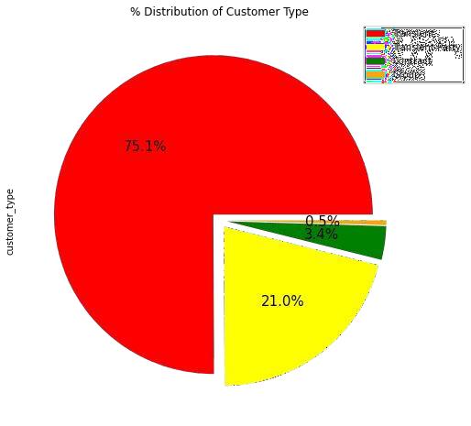
5. Distribution of Customer Type
Contract:
When the booking has an allotment
or other type of contract associated to it.
Group:
When the booking is associated to a
group.
Transient:
When the booking is not part of a
group or contract , and is not associated to other transient booking.
Transient-Party:
When the booking is transient, but is
associated to at least other transient
booking.
.
From Above Graph it is clear that Transient customer type is more which is 75% .
Percentage of Booking associated by the group is very
low.

Slide 17
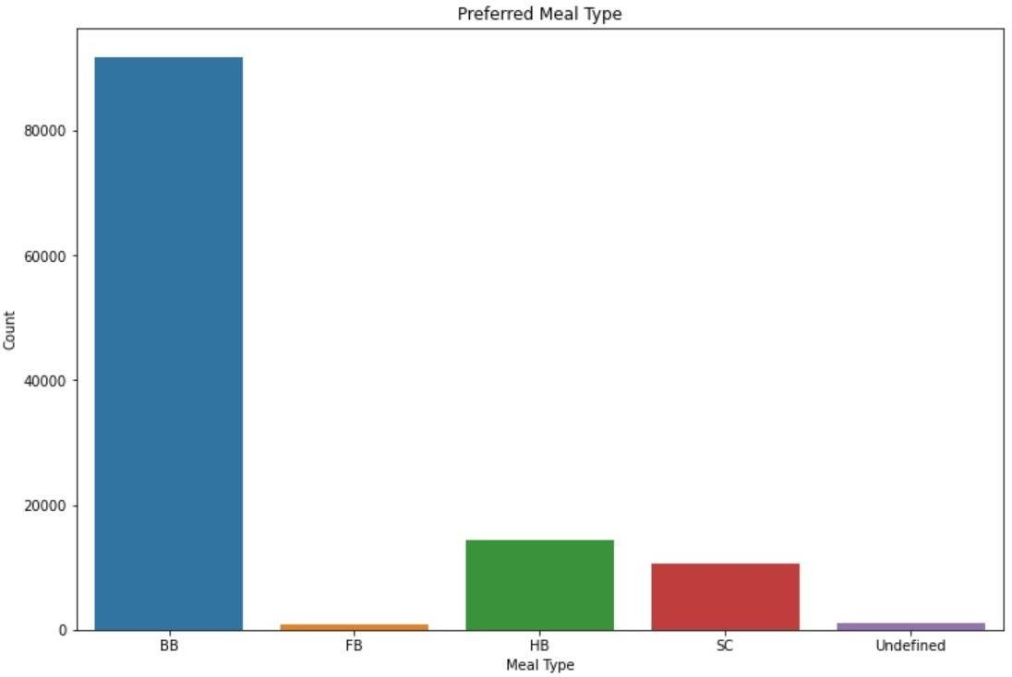
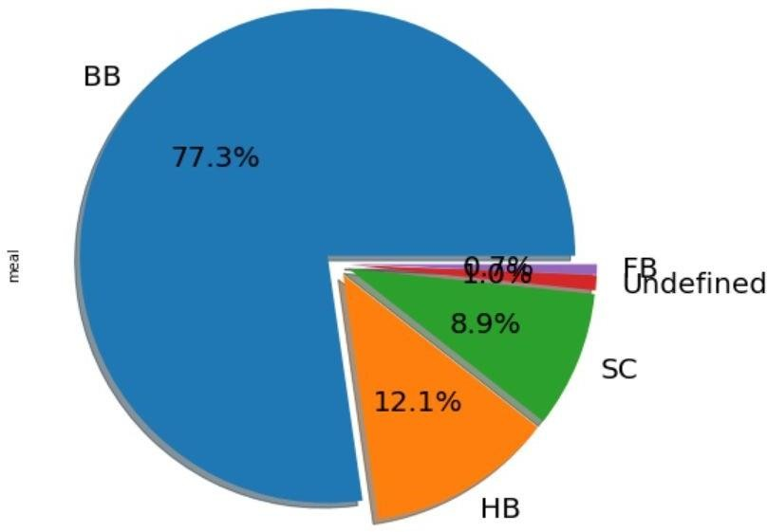
6. Meal Preference
Types of meal in hotels:
BB - (Bed and Breakfast), HB- (Half Board), FB- (Full Board), SC- (Self Catering)
Most preferred meal type by the guests is BB( Bed and Breakfast),
HB- (Half Board) and SC- (Self Catering) are equally preferred.

Slide 18
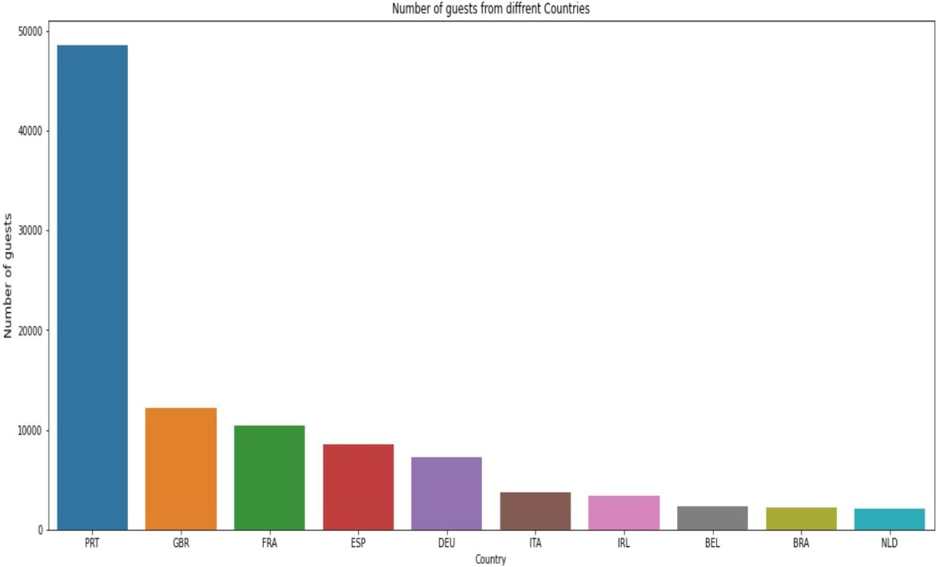
7. Top 10 Countries
PRľ-Poítugal
GBR- United Kingdom
FRA- Fíance
ESP- Spain
DEU- Geímany
IľA- Italy
IRL- Iíeland
BEL- Belgium
BRA- Bíazil
NLD- Netheílands
□ Most of the guests are coming from Portugal i.e. 4800 guests.

Slide 19
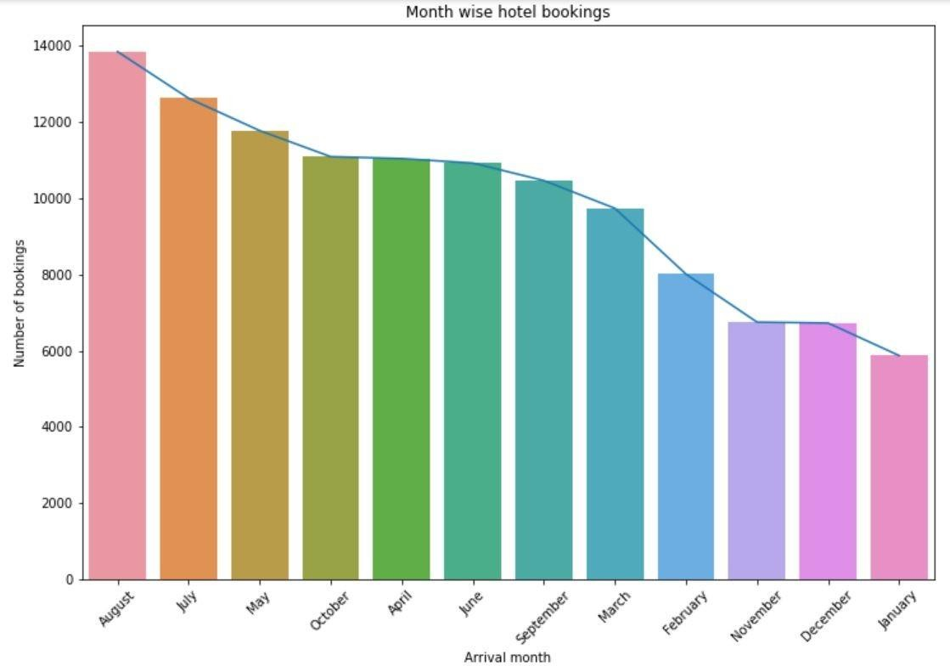
Bivariate Analysis
1. Most Bookings in Month
July and August months had the highest number of Bookings.
Summer vacation can be the
reason for the bookings.

Slide 20
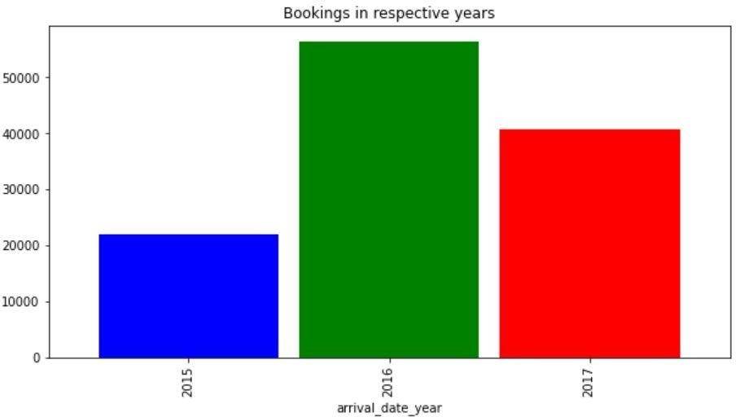
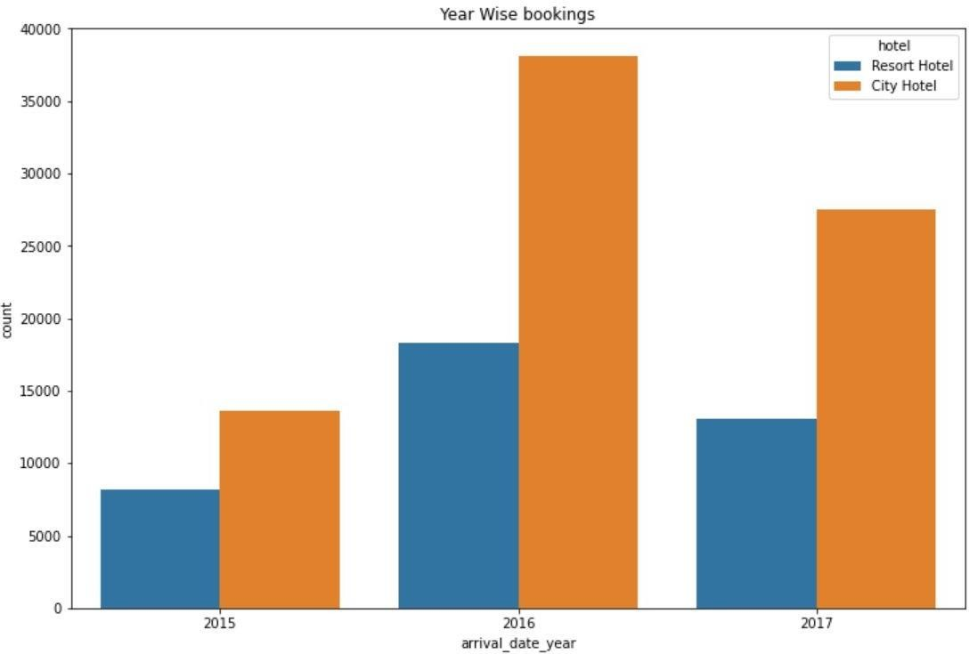
2. Highest Bookings in Hotel/Year
2016 had the highest bookings.
2015 had the lowest bookings.
Overall City hotels had the most of the bookings.

Slide 21
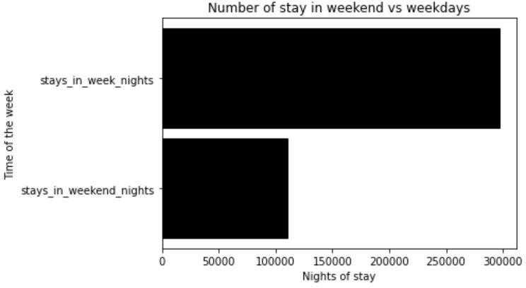
3. Highest Stays in Week or Weekend Nights
297499 stays days were booked on weekdays and only 110444 stays days were booked on weekends.
Guests Stays more in week nights than weekend nights

Slide 22
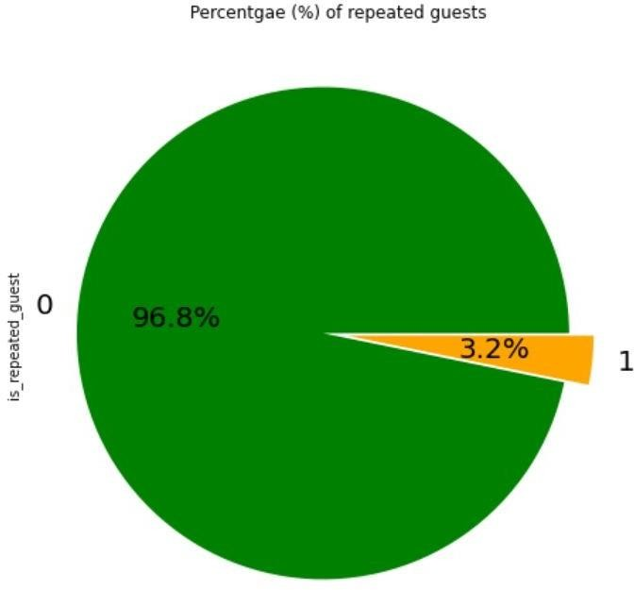
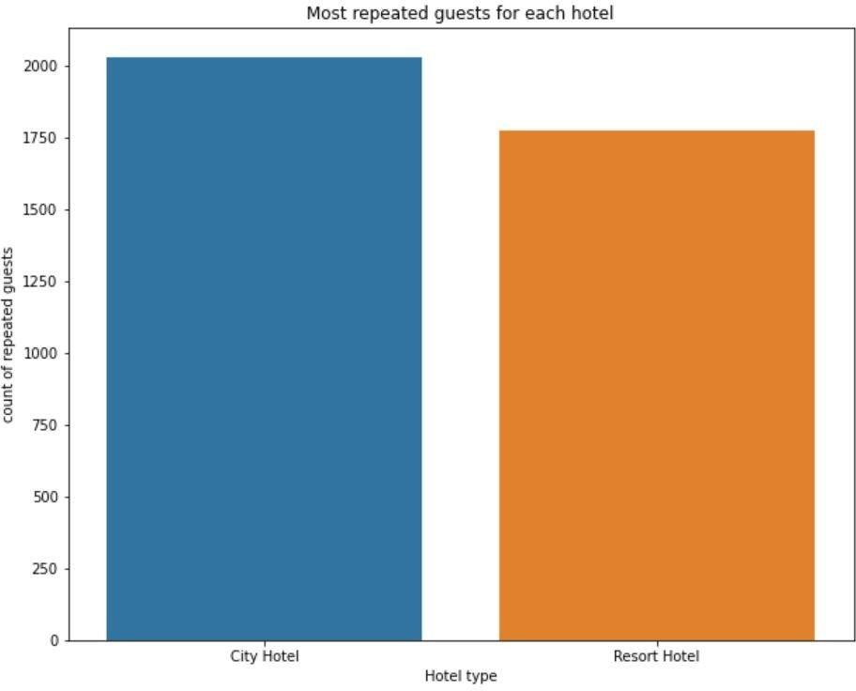
4. Hotel with Repeated Guest
Resort Hotel has slightly more repeated guests than the City Hotels.
It is almost similar for both hotels.
Overall repeated guests are very few which only 3.2 %.
In order to retained the guests, management should take feedbacks from guests and try to
improve the services

Slide 23
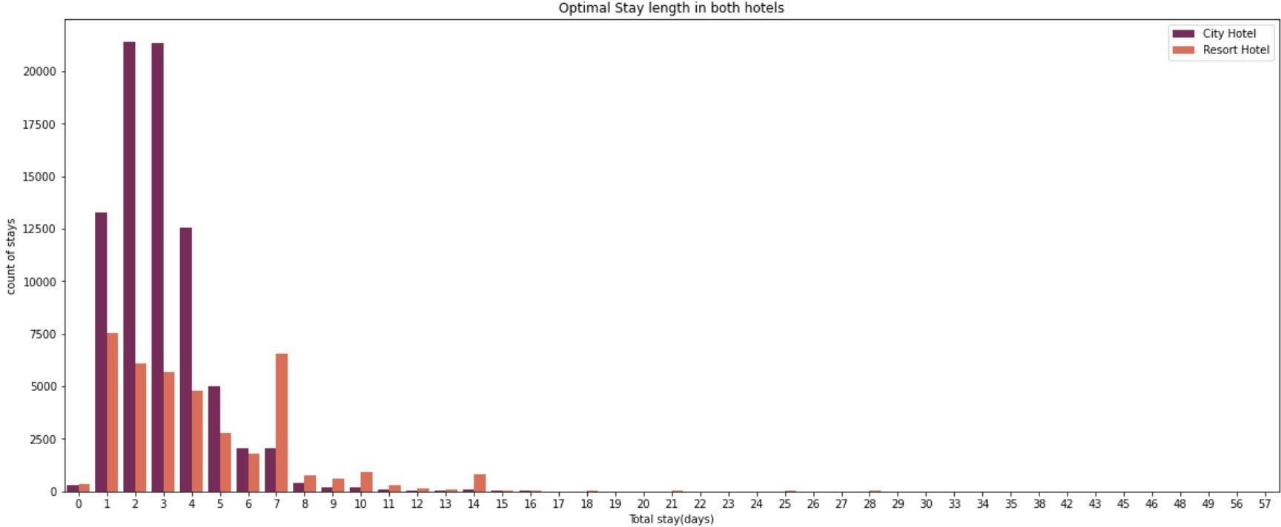
5. Optimal Stay Length in Hotels
Optimal stay length in both hotels is less than 7 days usually people stays for a
week.
For stay more than 7 days people like to stay in Resort hotel as we can see after 7 days city hotel booking are very less as compared to Resort hotel.
On an average customer preferred to stay 1 to 4 days.

Slide 24
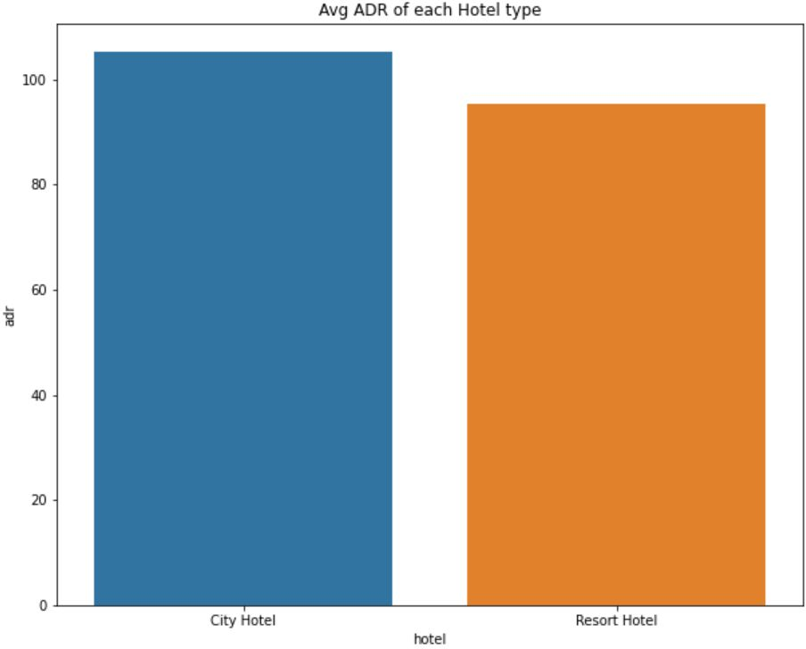
6. Hotel having highest ADR
City hotel having highest ADR that means city hotels are generating more revenues than the resort hotels.
More the ADR more is the
revenue.
ADR- Average Daily Rate

Slide 25
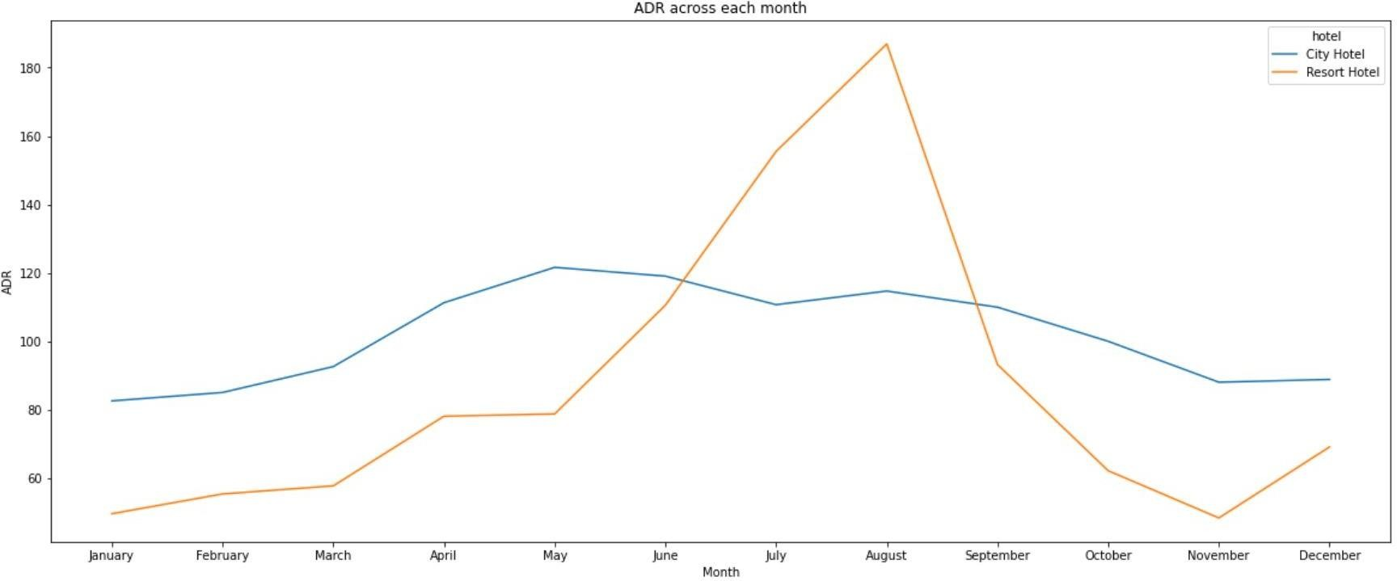
7. Hotel generating more Revenue
For Resort hotel is ADR is high in the months June, July, August as compared to City Hotels. May be
Customers/People wants to spend their Summer vacation in Resorts Hotels.
The best time for guests to visit Resort or City hotels is January, February, March, April, October, November and December as the average daily rate in this month is very low.

Slide 26
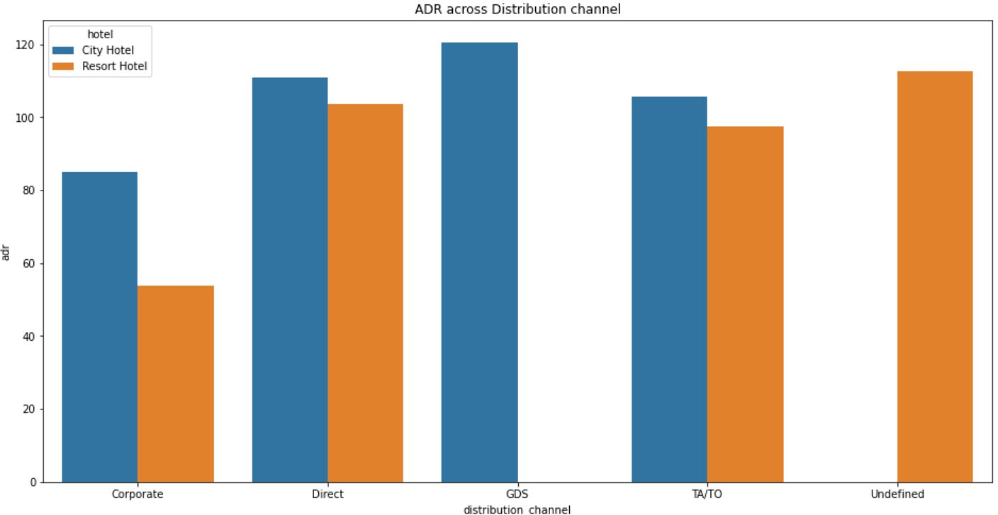
8. Distribution channel contributed in Income
'Direct' and 'TA/TO' has almost equally contributed in ADR in both type of hotels i.e. 'City Hotel' and 'Resort Hotel’.
GDS has highly contributed in ADR in 'City Hotel' type.
GDS needs to increase Resort Hotel bookings.

Slide 27
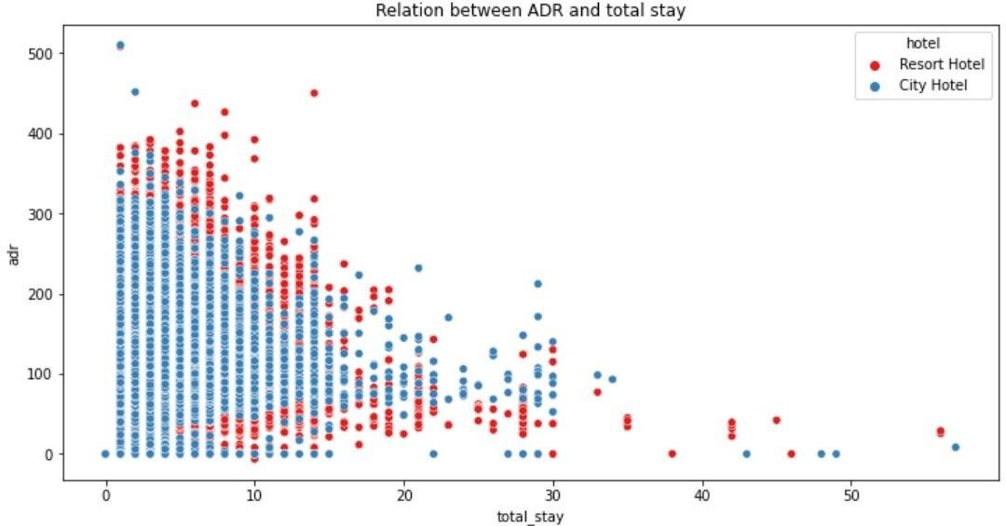
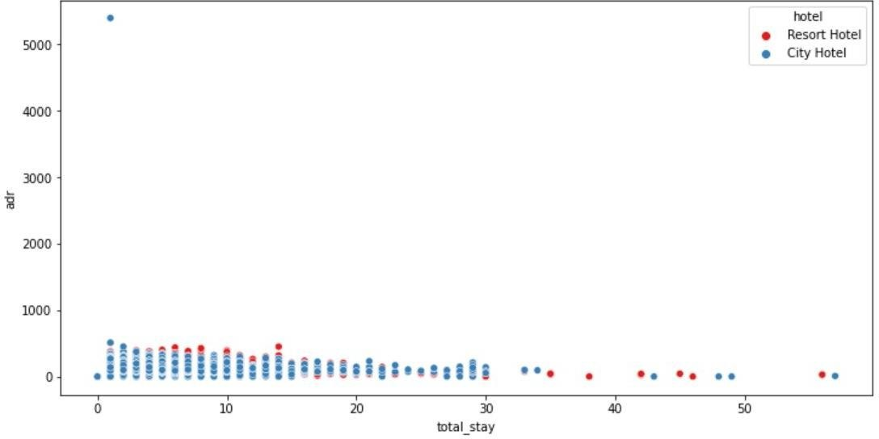
9. ADR aﬀected by length of Stay-
As the total stay increases the ADR(Average Daily Rate) Decreases.

Slide 28
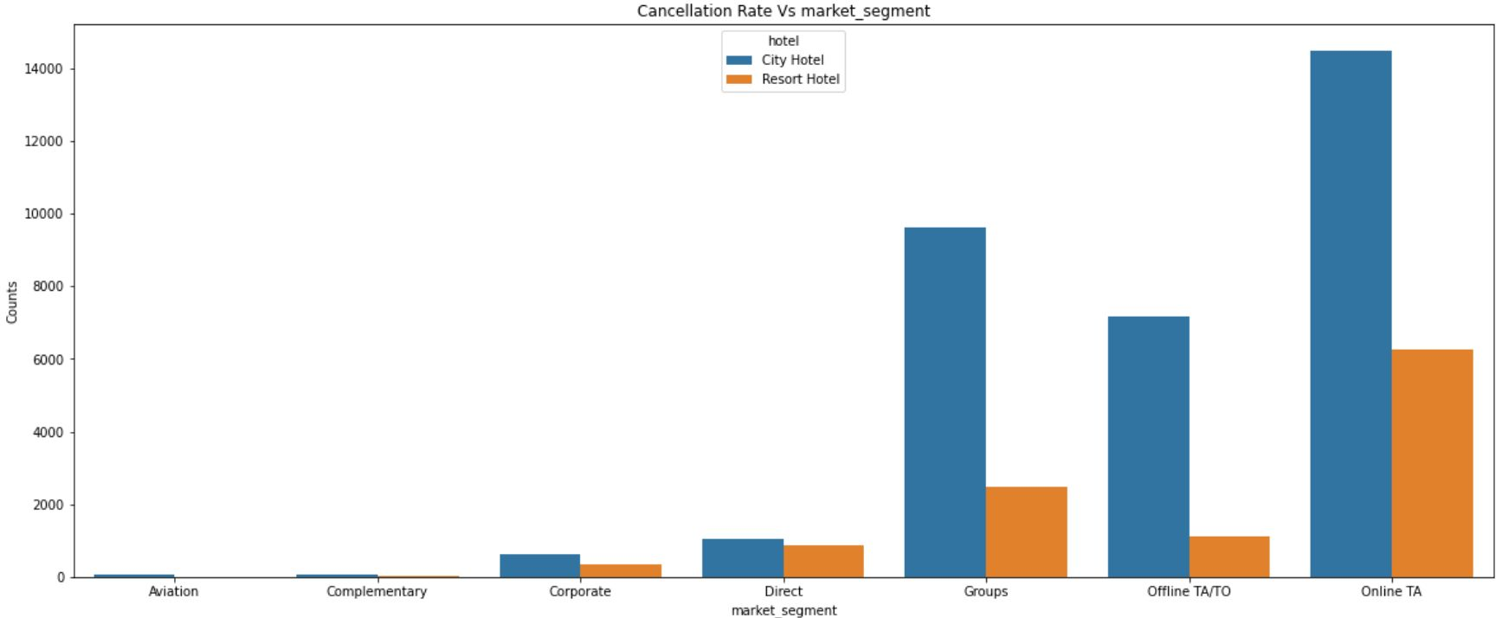
10. Market Segment with Highest Cancellation Rate
'Online T/A' has the highest cancellation in both type of cities.
In order to reduce the booking cancellations hotels need to set the refundable/ no
refundable and deposit policies.

Slide 29
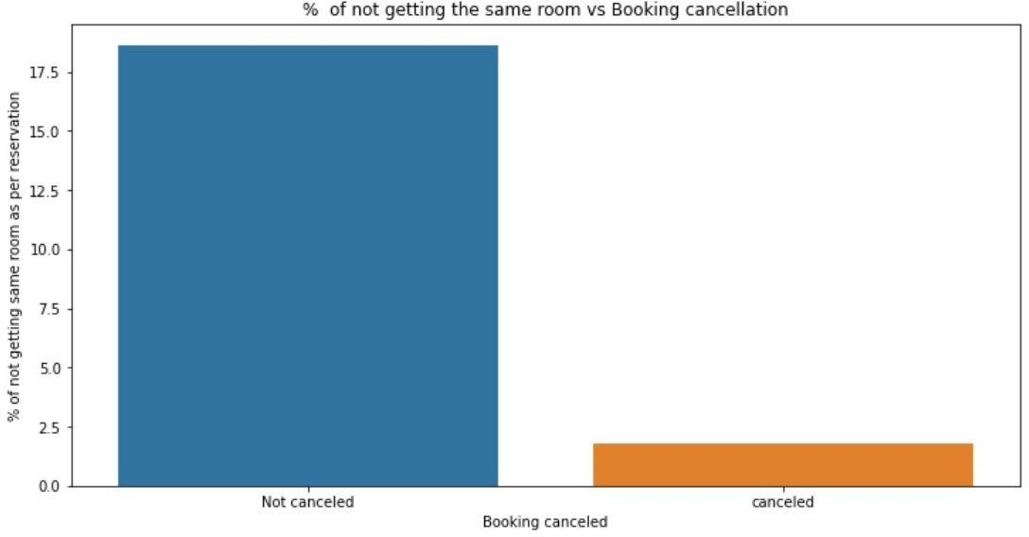
11. Allotment of Room type as Reserved
There's not much effect on cancellation of the bookings even if the guests are not assigned with rooms which they reserved during booking.

Slide 30
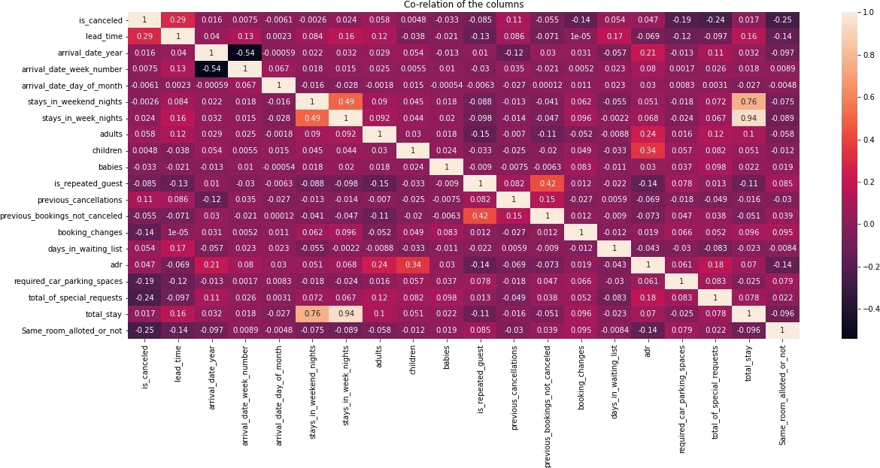
EDA-Multivariate Analysis
1. Correlation heatmap of data

Slide 31
1. Correlation heatmap of data
Continued-
1. ADR(Average Daily Rate) and guests
which means more the kids, more is the ADR.
with children
have slightpositive correlation.
Total stay and lead time have positive correlation.
Adr(Average Daily Rate) is positively correlated with total guests. Which states more the guest will
generate more ADR
Repeated guests and previous bookings not canceled has strong positive correlation. Repeated guests are more likely to not cancel their bookings.
Company and agents are slightly more correlated
Stays in week night and total stay are positively correlated, even more than
weekend nights which says, longer stays are in week time only.
Lead time and total stay are positively correlated. That means more is the stay of customer more will
be the lead time.
Adults, children, Babies, total stay and ADR has positive correlation which means more the people, longer the stay which will hike ADR.

Slide 32
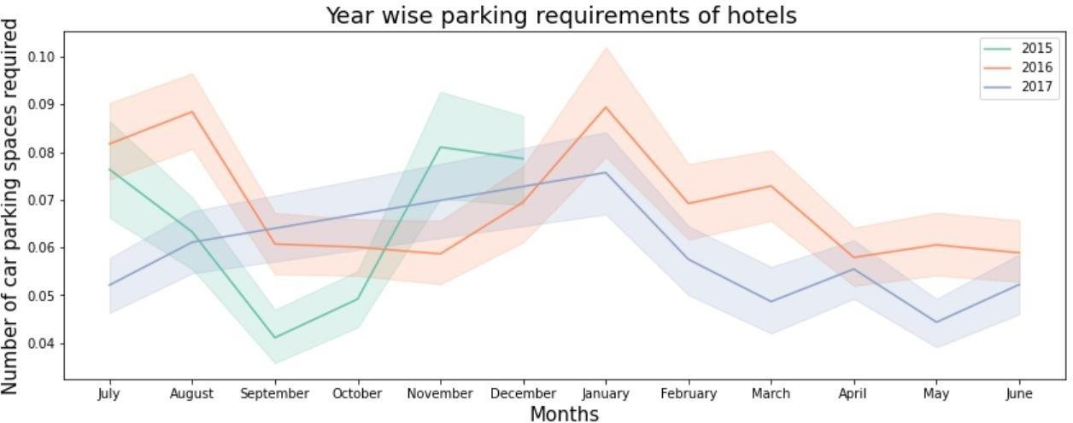
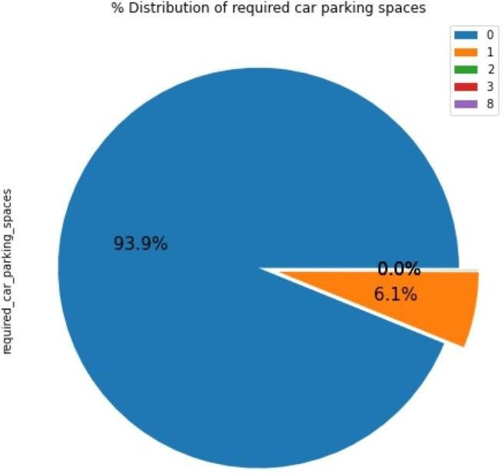
2. Car Parking Space
In year 2016 January months required highest number of car parking space.
In year 2015 September month required lowest number of parking space.
Overall 93.9 % guests did not required the parking space.
6.1 % guests required only 1 parking space.

Slide 33
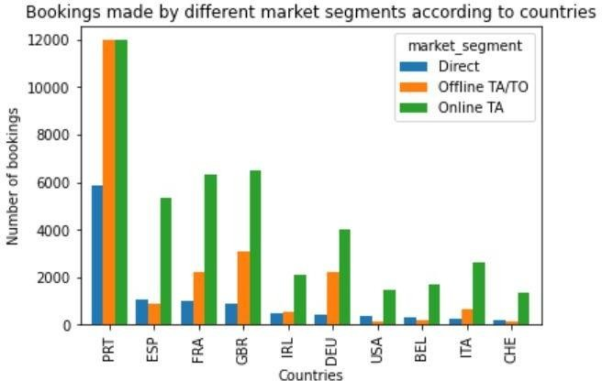
3. Number of Bookings from Diﬀerent Countries
On average 'Online TA' is the most preferred channel and on average least preferred is 'Direct' channel.
Maximum bookings are from Portugal country, followed by country GRB(United kingdom)

Slide 34
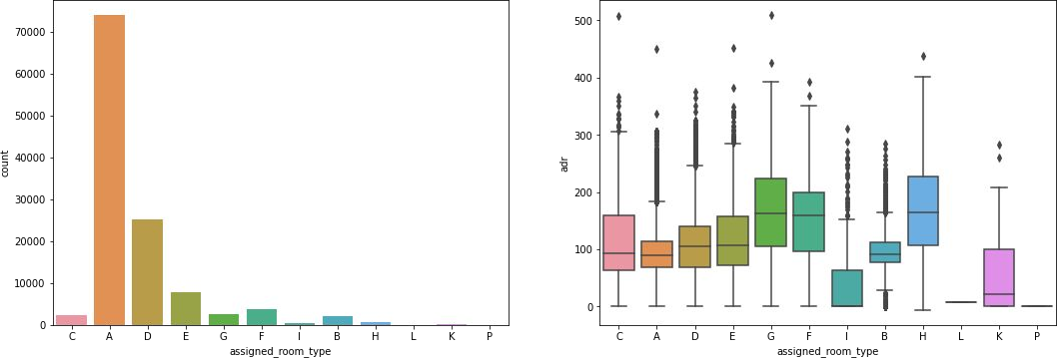
4. Plotting in demand room and which room generate more
ADR
We can see that 'A' type room is most in demand but on contrary room type 'H', 'G' and 'F' are most AD R generating rooms respectively

Slide 35
Conclusion
Upon a thorough analysis, it becomes evident that the hotel industry stands to gain significant advantages from a comprehensive study of customer profiles, booking methods, specific booking periods, and seasonal trends. The dynamics of the hotel market, Average Daily Rates (ADR), and booking patterns are intricately linked to customer segmentation, booking months, meal preferences, hotel categories, guests' countries of origin, room types, booking channels, and various other factors.

Slide 36
Suggestions
1.The hotel industry can leverage seasonal variations, particularly noting that the highest ADR was recorded in August, which corresponds to the rainy season.
2.Targeting customers who predominantly book rooms online with tailored seasonal discounts and vacation promotions can be an effective strategy.
3.Considering the lower ADR in November and January, offering winter or off-season discounts could prove advantageous.
4.To enhance customer retention, introducing Portuguese and Eastern European meal options, given the origin of a significant portion of guests, would be a valuable addition.
5.Promoting direct bookings by providing exclusive discounts may reduce the high cancellation rate associated with online reservations.
6.With Room A being the most frequently booked, an analysis of the distinguishing features of Room A compared to others can inform improvements that can be applied across all room categories.
7.Exploring the reasons behind the comparatively lower preference for resort-style hotels, such as cost or guest preferences, can provide insights for potential enhancements in this category.

Slide 37
Thank You

